Slide 1
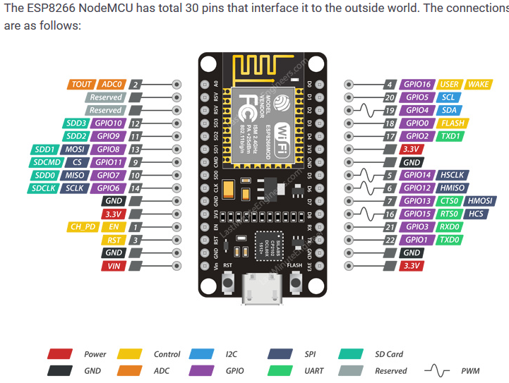

Slide 2
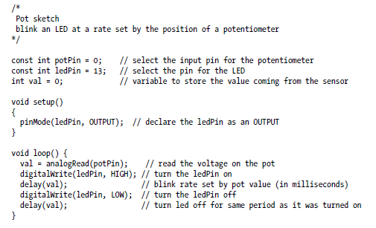

Slide 3
Changing the Range of Values
You want to change the range of a value, such as the value from analogRead obtained by connecting a potentiometer or other device that provides a variable voltage.
Example, suppose you want to display the position of a potentiometer knob as a percentage from 0 percent to 100 percent.

Slide 4
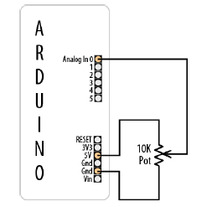
Map Function:
map(value, fromLow, fromHigh, toLow, toHigh)
a value of fromLow would get mapped to toLow, a value of fromHigh to toHigh, values in-between to values in-between.

Slide 5
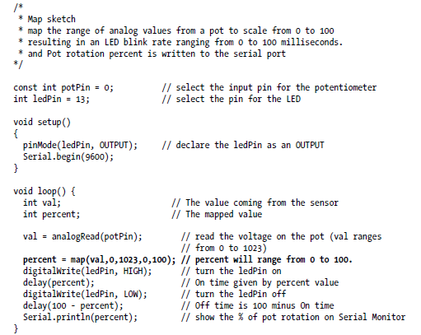
Arduino Sketch

Slide 6
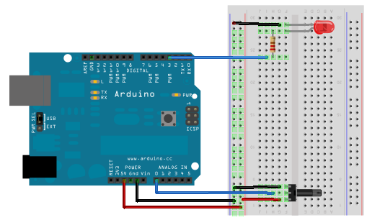
Adjusting LED brightness

Slide 7
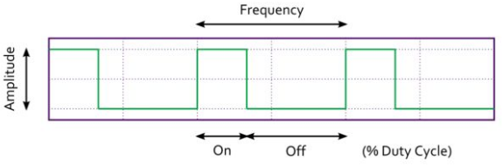
What is PWM?
Pulse Width Modulation (PWM) is a technique for creating a digital square wave signal.
A square wave has 3 main characteristics
  Amplitude - The amount the signal changes between On and Off states
  Frequency - The number of times the signal repeats in a given time frame
  Duty Cycle - The proportion of On time to Off time usually expressed as a percentage

Slide 8
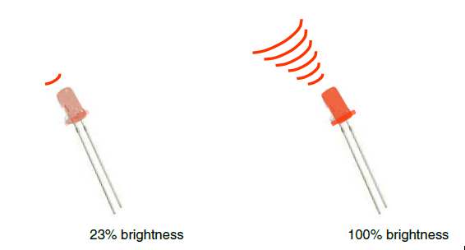
Analog Output
Can a digital devise produce analog output?
Image from Theory and Practice of Tangible User Interfaces at UC Berkley
Analog output can be simulated using pulse width modulation (PWM)

Slide 9
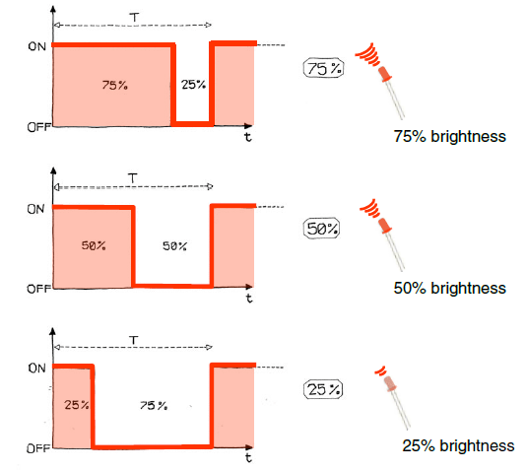
Pulse Width Modulation
Can’t use digital pins to directly supply say 2.5V, but can pulse the output on and off really fast to produce the same effect
The on-off pulsing happens so quickly, the connected output device “sees” the result as a reduction in the voltage
Image from Theory and Practice of Tangible User Interfaces at UC Berkley

Slide 10
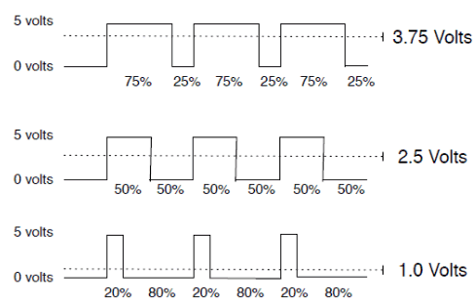
PWM Duty Cycle
output voltage = (on_time / cycle_time) * 5V
Image credit: Tod Kurt
Fixed cycle length; constant number of cycles/sec

Slide 11

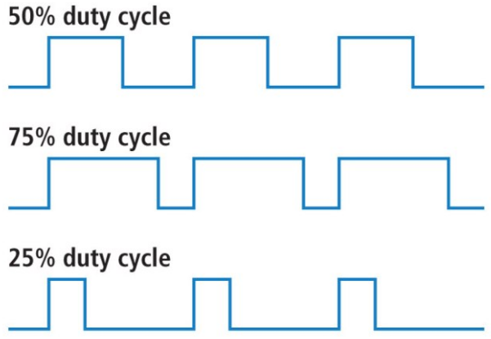
Duty cycles

